Slide 1
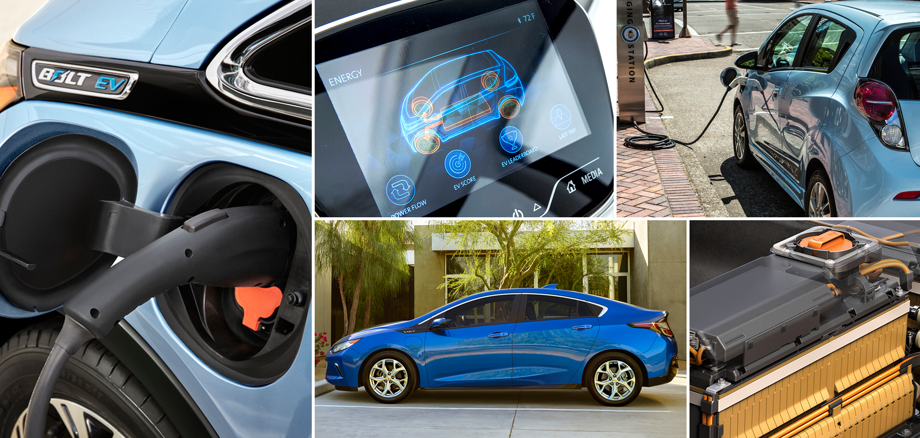
Research highlights associated with the characterization of battery materials for electrified vehicle applications
Mark Verbrugge and Daniel Baker
A conference in honor of Charles Wampler, "Polynomials, Kinematics, and Robotics," June 5 - 7, 2017, at the University of Notre Dame, McKenna Auditorium

Slide 2
Contents for this talk
A few slides on electrified vehicles and a schematic exhibiting the anatomy of a lithium ion battery
Irreversible thermodynamics for treating diffusion and migration
  Dilute-solution theory
  Concentrated solution theory
Porous electrode theory applied to lithium ion electrodes
Life modeling of lithium ion cells

Slide 3
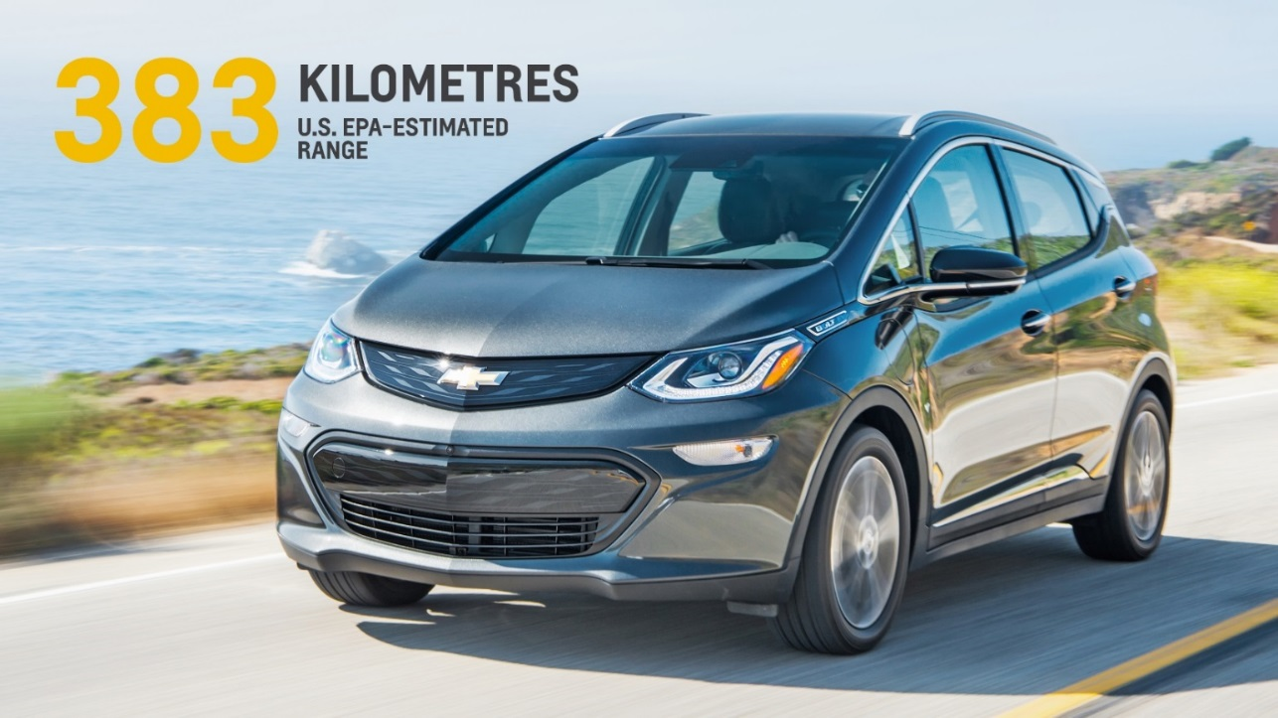
2017 Chevrolet BOLT
238 miles, 383 km of EV range
MSRP: $37,495
  $29,995 after the federal tax credit
0 to 60 mph in less than 7 seconds
Notes:
Breakthrough battery technologies are allowing us to build electric vehicles with better performance, faster recharging times, longer ranges, and greater versatility and functionality than ever before.
The 2017 Chevrolet Bolt EV does more than set a new benchmark for affordable, long-range EV driving. It also raises the bar when it comes to driving performance.
Engineers developed the Bolt EV’s propulsion system to offer more than an estimated 200 miles (based on GM estimates) and a delightful driving experience that’s more akin to a compact sports sedan than a small utilitarian crossover.
Source: GM news releases, 01/12/15 and 01/11/16.
JGS_MTC22

Slide 4
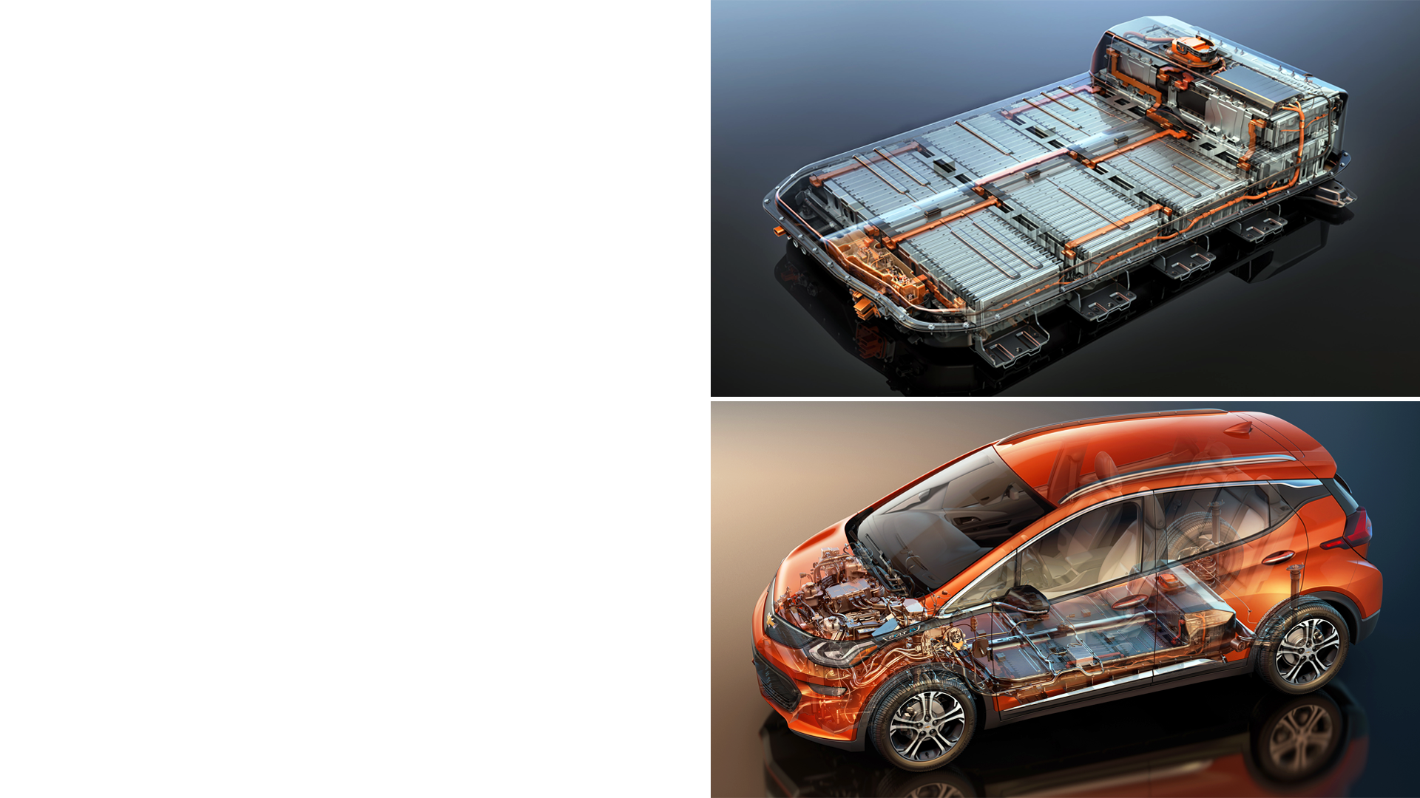
Chevrolet bolt
60 kWh lithium-ion battery pack
160 kW of peak power
288 lithium ion cells in
96 cell groups
  For the most part, if you understand the cell, you understand the pack
960 lbs. (435 kg) total weight…at the pack level:
  138 Wh/kg
  368 W/kg
Notes:
60 kWh Battery System
Bolt EV battery engineers and strategic partner LG Electronics develop an all-new cell and battery pack. The nickel-rich lithium-ion chemistry provides improved thermal operating performance over other chemistries, which requires a smaller active cooling system for more efficient packaging.
Battery system preliminary specifications include:
-60 kWh lithium-ion battery pack
- 288 lithium ion cells
- 960 lbs. (435 kg) total weight
The system provides 160 kilowatts of peak power and 60 kilowatts hours of energy.
The battery system is mated to a standard equipment 7.2 kW onboard charger for regular overnight charging from a 240-V wall box. A typical commute of 50 miles can be recharged in less than two hours. Bolt EV also features an optional DC Fast Charging system using the industry standard SAE Combo connector. Using DC Fast Charging, the Bolt EV battery can be charged up to 90 miles of range in 30 minutes.
Source: GM news release, 01/11/16.
RDO21

Slide 5

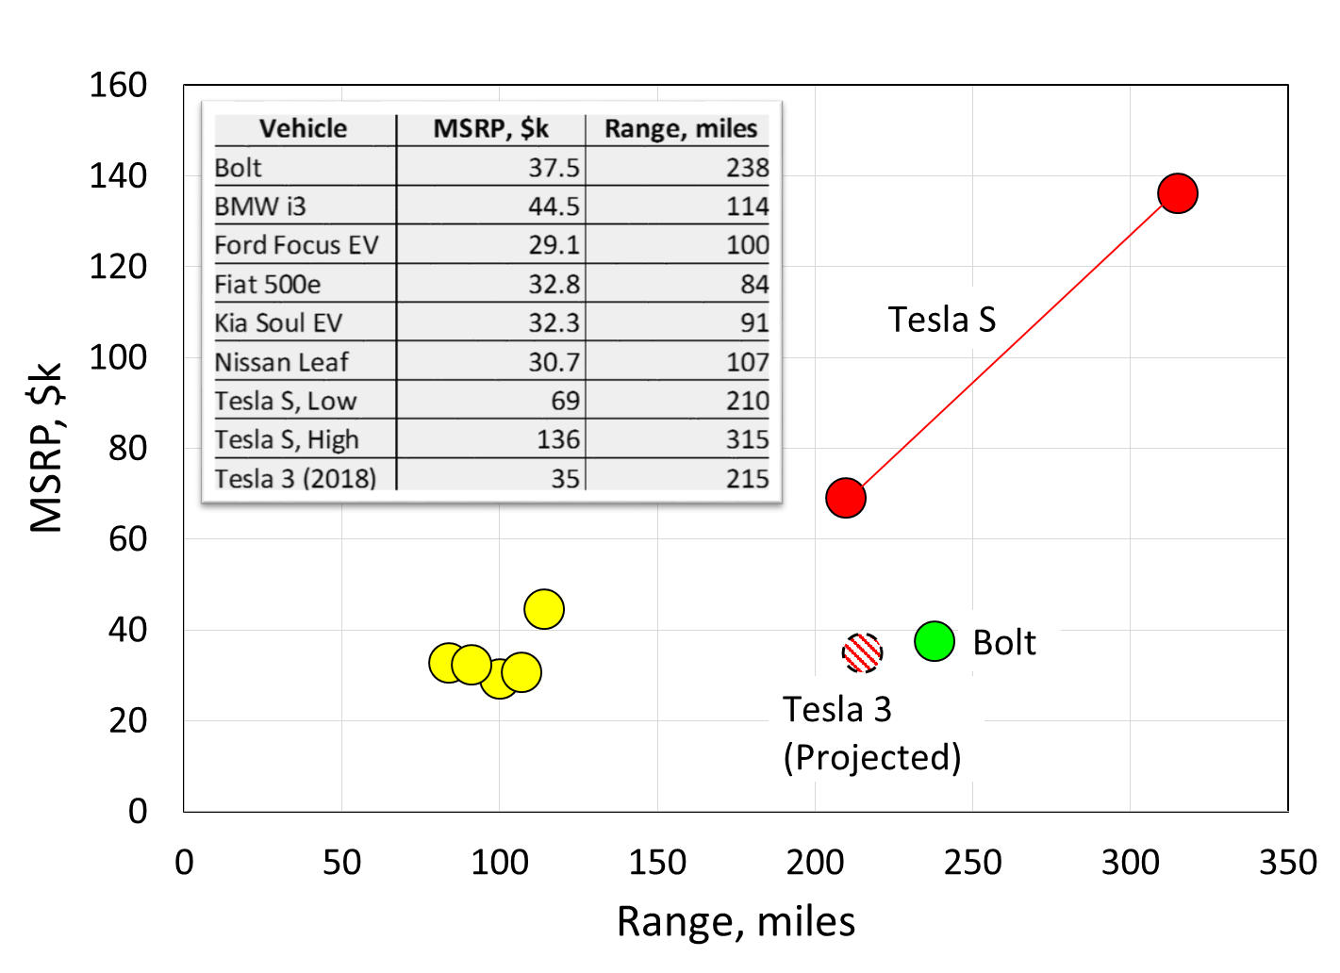
Car and Driver …benchmarking
http://www.caranddriver.com/chevrolet/bolt-ev
The competition will be fierce!

Slide 6

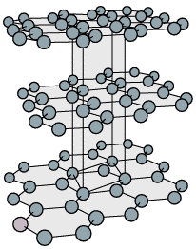
Anatomy of a Lithium-Ion Battery
(‒)
CHARGE
DISCHARGE
~100 μm
V
(+)
PF₆⁻
Li⁺
PF₆⁻
e⁻
~5 μm
PF₆⁻
Li⁺
Li⁺
Li⁺
Li⁺
Porous Electrode
Liquid phase
Solid phase
Electro-chemical reaction at the liquid-solid interface
PF₆⁻
Li
  ~3.5 Å
Carbon Electrolyte Metal oxide
By putting energy into the cell, lithium is forced out of the metal oxide (positive) and into the graphite (negative).
Positive electrode is full of lithium at the end of discharge
Notes:
6

Slide 7
A personal perspective
First, there was the Li metal negative and the LiMn₂O₄ positive
  Durability
  Safety
Afterwards, companies switched to lithiated graphite negatives (“LiIon”)
Next several slides overview some mathematical modeling elements of our journey along this path

Slide 8
Transport equations describe the simultaneous processes of diffusion by concentration variations and migration by potential variations, but these equations can be greatly simplified for benchmarking purposes…dilute solution theory
Similarly, we simplify the electrochemical reaction equation.
~1x10⁻¹³ F/cm in conventional liquid electrolytes

Slide 9
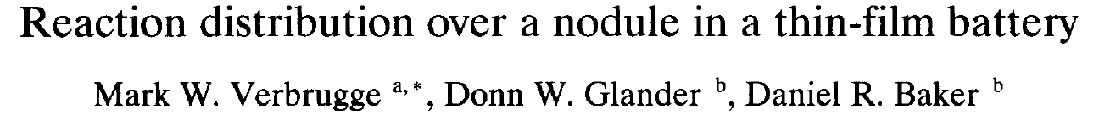


Secondary current distribution with linear charge-transfer kinetics
$$\sim \frac{ Ohmic resistance}{Reaction resistance}$$
c
Metal oxide electrode
Examine active and passive surrounding anode…which is preferred?
a
Lithium
electrode
b
d →
c
↑
d
a
b
Surrounding electrode:
  More nonuniform current distribution
  But lower average (nodule) current
  Metal electrodes are problematic

Slide 10
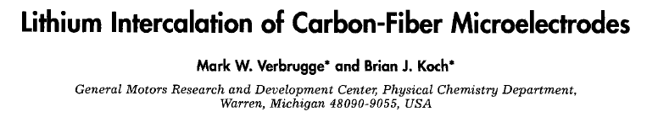
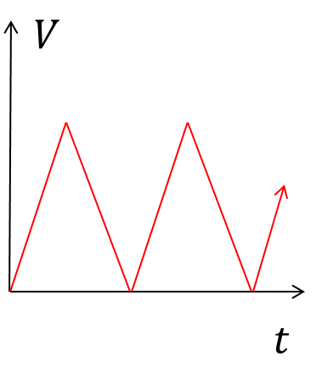
Ability of lamellar compounds of carbon to insert various species was well known by the later half of the 1800s (Schauffaütl, 1841…Sony, 1992)
Aprotic solvents with high dielectric constants: W.S. Harris, Ph.D. Thesis, University of CA, Berkeley, 1958.
Single fiber electrode: phenomena associated with the fabrication of a porous electrode do not obfuscate the subsequent characterization…use the Scientific Method to isolate critical characteristics (changed our focus then from Li⁰ to LiIon)
Extremely stable lithiated carbon anode and Li reference

Slide 11
α plays a key role (similar to the Biot number in heat-transfer problems)
  This behavior frequently arises in electrochemical problems…note, “electrochemistry” refers to the study of charge-transfer reactions
Γ transform allows one to address the two length scales in a pragmatic manner…I’ve found this useful in other analyses

Slide 12
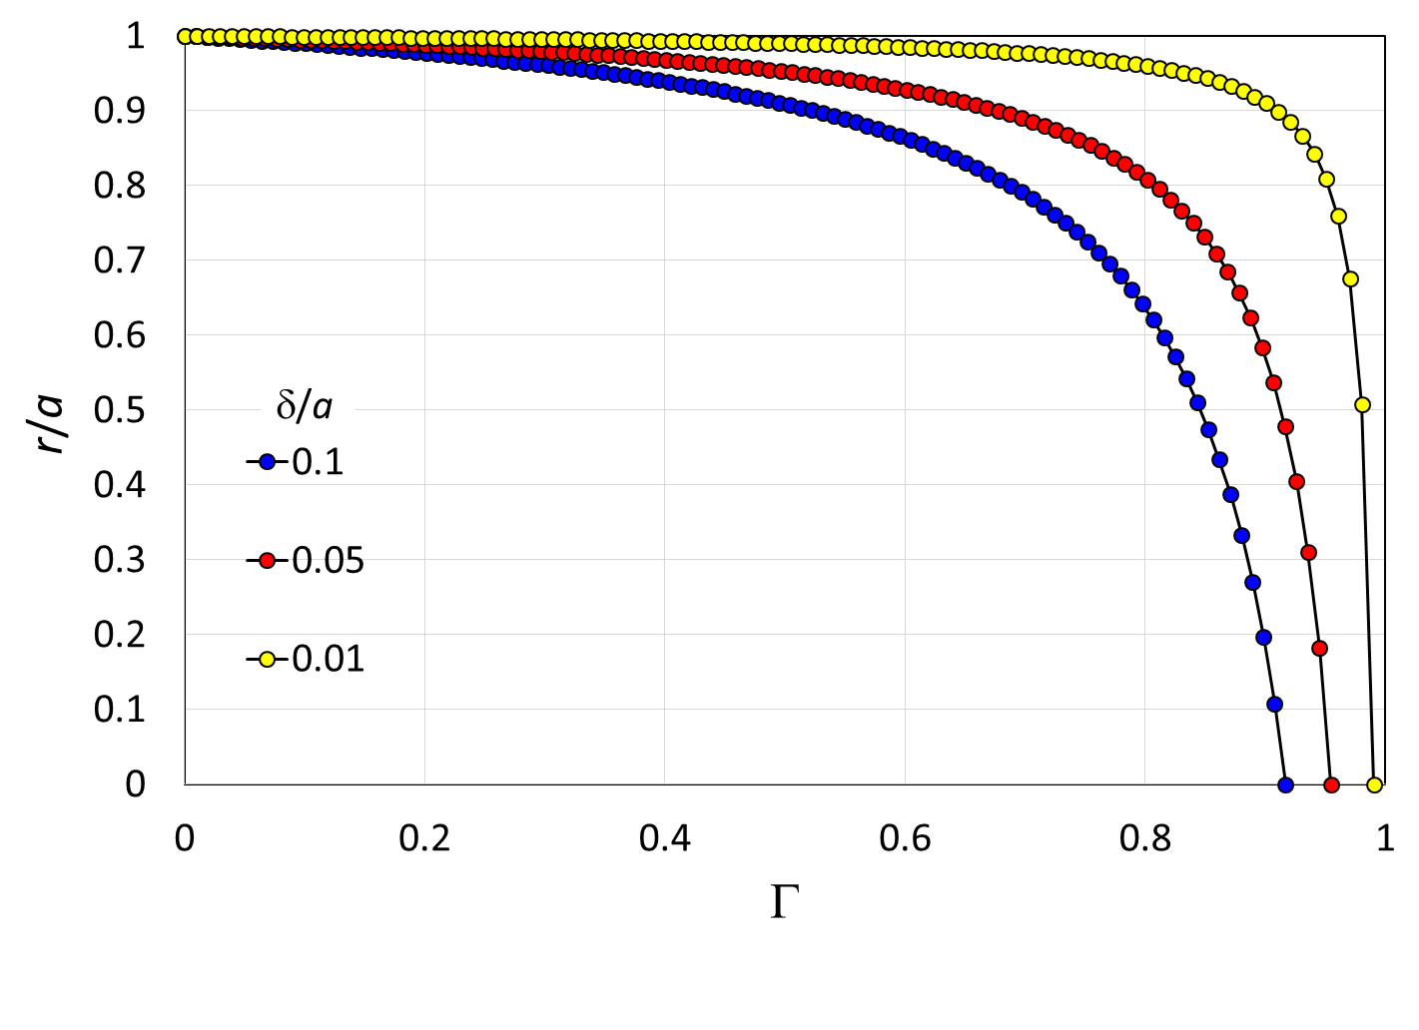
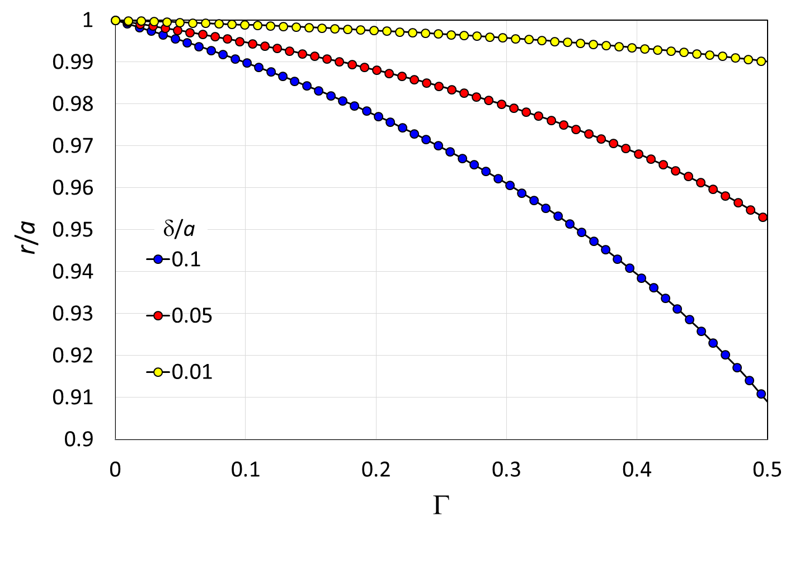
About half of the mesh points in Γ are within the boundary layer δ/a near the fiber surface
Chain rule is used to transform equations from (t, r) to (t, Γ) coordinates
Helpful for infinite domains (r → ∞, Γ→ 1)

Slide 13
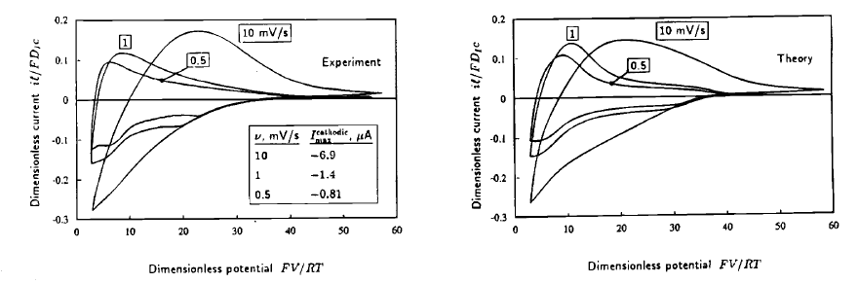
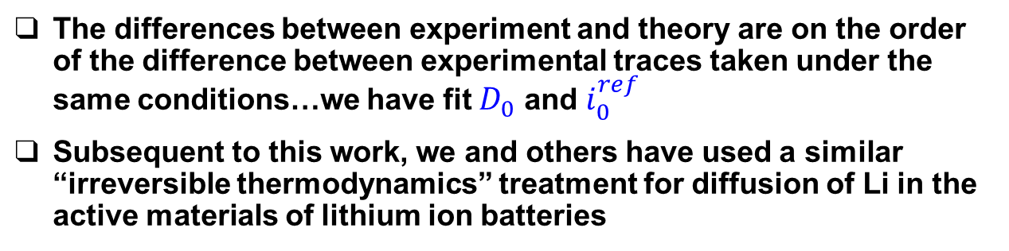
The differences between experiment and theory are on the order of the difference between experimental traces taken under the same conditions…we have fit $D_{0}$ and $i_{0}^{ref}$
Subsequent to this work, we and others have used a similar “irreversible thermodynamics” treatment for diffusion of Li in the active materials of lithium ion batteries

Slide 14
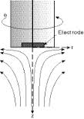
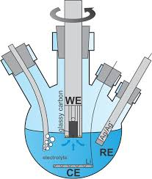






“Convective Diffusion to a Rotating Disk,”
M. W. Verbrugge, J. Electrochem. Soc., 139(1992)3529
O₂
von Kármán transformation for velocity components & pressure
Γ = 1
Γ = 0
$$z→∞$$
C
$$z$$
Dilute solution theory
Ω
$$r>a,z=0$$
$$r$$
D →
Insulating surface
C
A B
$$r=0$$
D
Center line
B
$$r<a,z=0$$
A
Electrode
θ = 0 θ = π/2

Slide 15
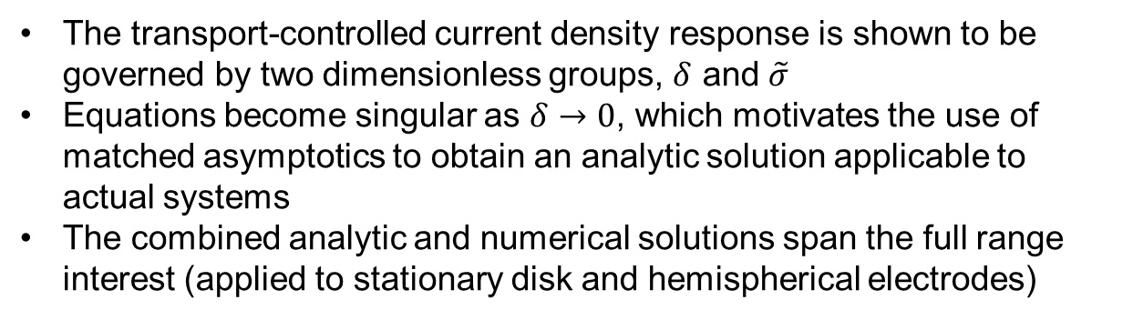
The Role of Charge Separation in the
Response of Electrochemical Systems,
D. R. Baker and M. W. Verbrugge, Proc. R. Soc. Lond. A, 454(1998)1805.
Dilute solution theory
The transport-controlled current density response is shown to be governed by two dimensionless groups, $δ$ and $\tilde{σ}$
Equations become singular as $δ→0$, which motivates the use of matched asymptotics to obtain an analytic solution applicable to actual systems
The combined analytic and numerical solutions span the full range interest (applied to stationary disk and hemispherical electrodes)
Axial coordinate transformation for numerical calculations

Slide 16
Context for subsequent electrochemical analyses & tools
We need to model many different materials and electrode architectures reflecting various types of batteries for different applications
  Start/stop, HEV, PHEV, BEV) and
  differing electrode and electrolyte materials
We need easier methods than exist currently for processing large amounts of cell data
  All analytic solutions we present in the following can be implemented in “spreadsheet software” (e.g., Excel)
  The EIS, PITT, and GITT solutions have a great deal of similarity, as they all arise from small signal excitation
The solutions have two other less direct benefits
  Provide an elementary understanding of how electrodes work
  Provide simple expressions that can be used to check the accuracy of more detailed numerical models

Slide 17
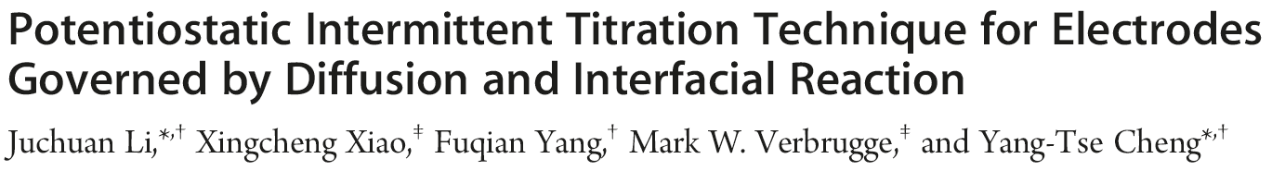



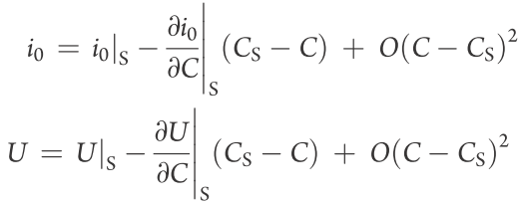


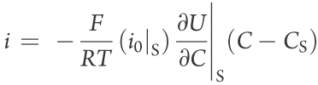



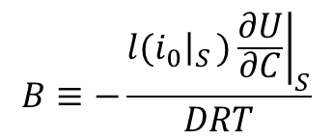


…PITT
$$V$$
$$t$$
Thin-Film
Electrode
Taylor series expansion about the final state S
Thin-film (100 nm) electrode (lithiated Si)
Small potential step excitation: linearize about the open-circuit potential and linearize about solute (Li) final concentration.
Electrochemical Biot number B: lone dimensionless group
$$B≡−\frac{l{\left.{(i}_{0}\right|}_{S}{\left.)\frac{∂U}{∂C}\right|}_{S}}{DRT}$$
$$=\frac{Diffusion resistance}{Electrochemcial reaction resistance}$$

Slide 18
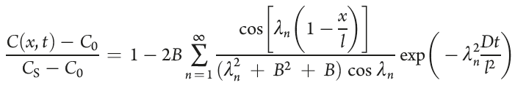

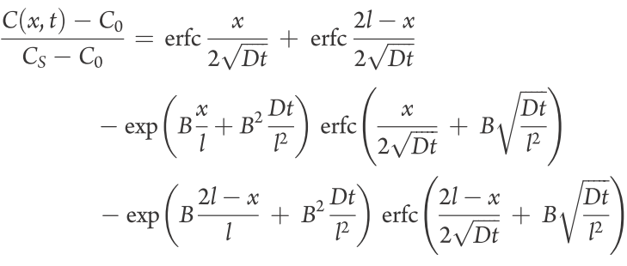
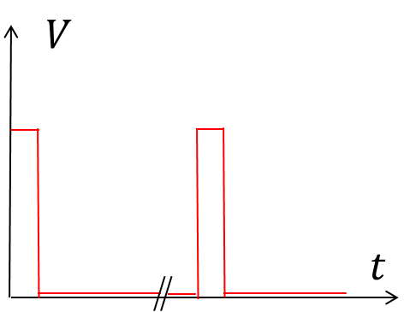
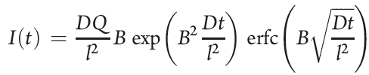


For long times, we retain only the n = 1 term
Short-time solution
Short time solution
Long time solution
Total charge associated with the potential step is
$$Q={FlA(C}_{S}−C_{0})$$

Slide 19
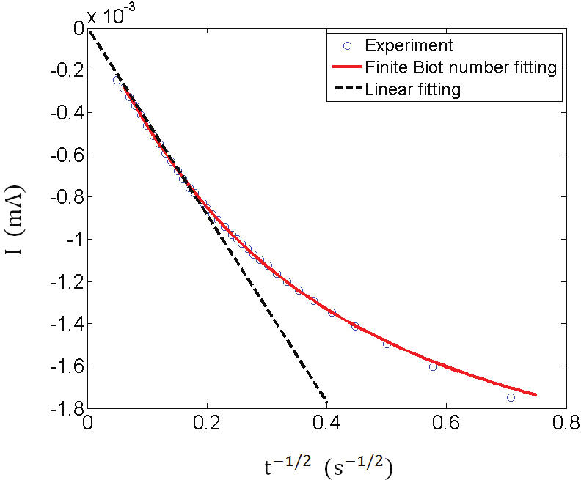
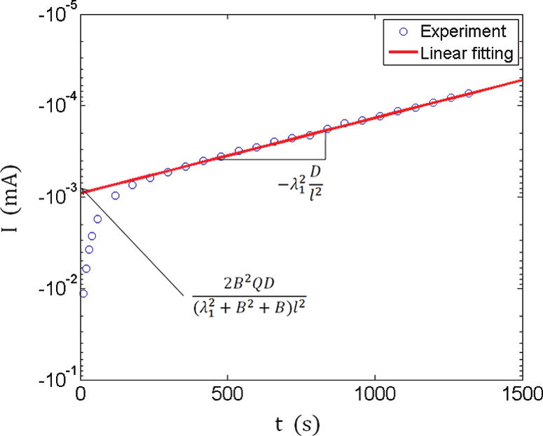
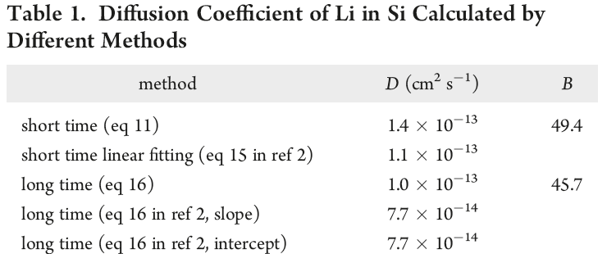
Short time comparison Long time comparison
(red line)
For these results, potential was stepped from 0.395 to 0.390 V vs Li (Li⁺ reduction)
Diffusion of Li in Si is about 3 orders of magnitude slower than in graphite

Slide 20




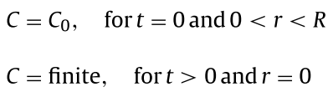
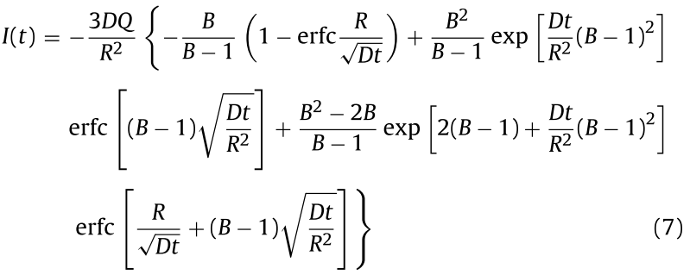

Approach is completely analogous to that taken for the thin film
Electrode
particle
Short time solution, Dt/R² << 1
Long time solution, Dt/R² >> 1

Slide 21
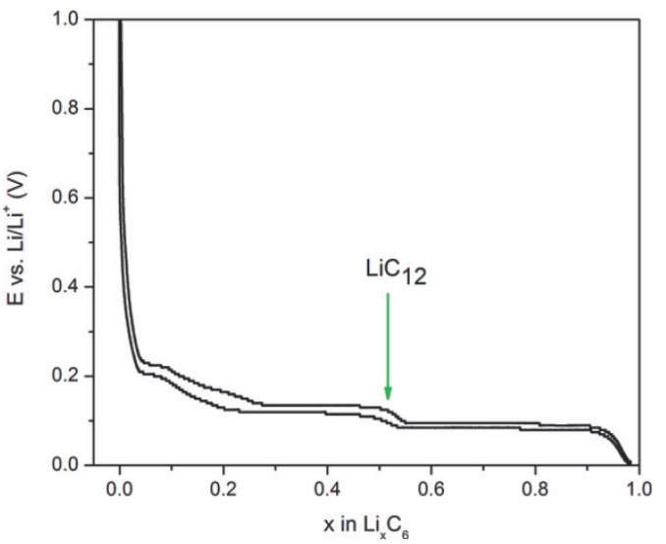
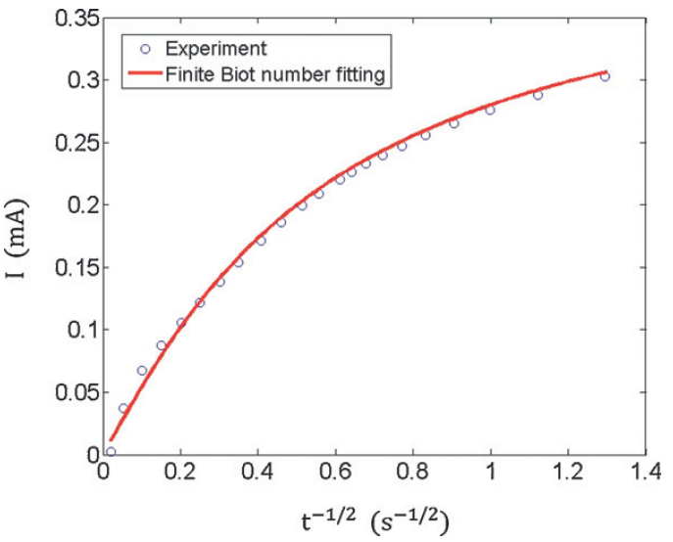
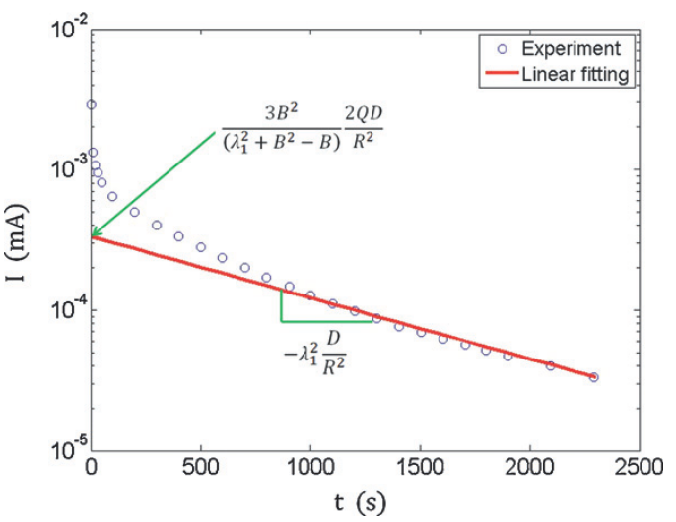
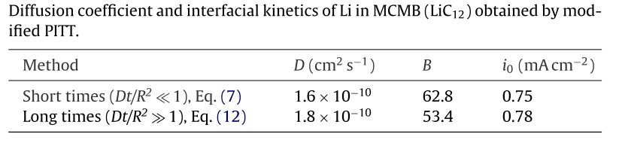
Short times, Dt/R² << 1
Long times, Dt/R² >> 1
The porous electrode is made of large (18 μm dia.), spherical carbon particles, intending to ensure that diffusion resistance dominates Ohmic drop
Results are in good agreement with measurements on single carbon-fiber electrodes mentioned previously

Slide 22
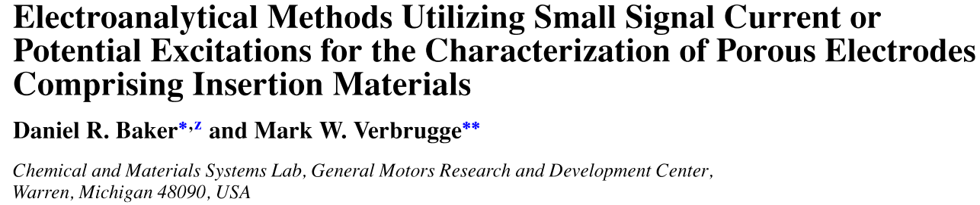
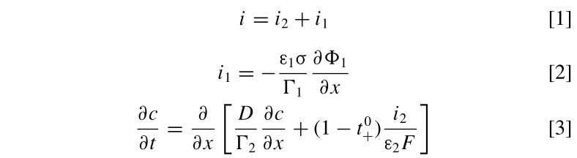
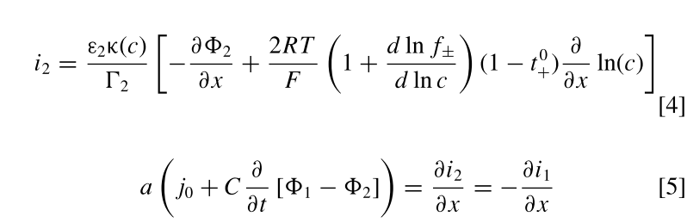

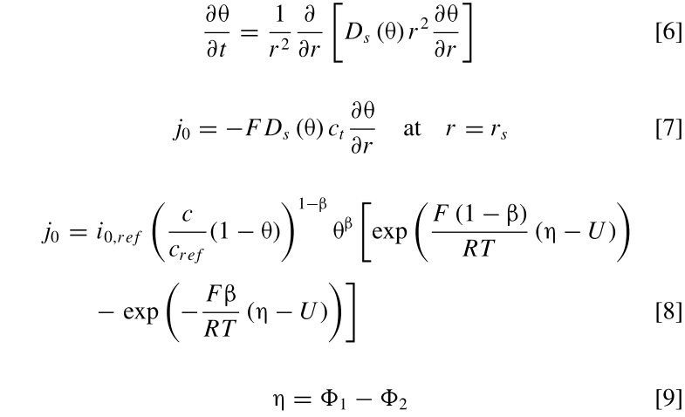
Porous Electrode
Spherical active material
Binder & conductive diluents
Electrolyte (subscript 2)
Porous electrode
(subscript 1)
Nine equations, along with initial and boundary conditions, have been employed to describe porous electrodes (e.g., Doyle, Fuller, Newman publications in early 1990’s and used today)
As previously, we linearize about a small excitation source (PITT, GITT, & EIS)
Double-layer capacitance is ignored in the PITT & GITT analytic solutions (msec phenomena)
Intra-particle & particle surface
Volume averaging to juxtapose liquid and solid phases and formulate continuum equations (concentrated solution theory)

Slide 23
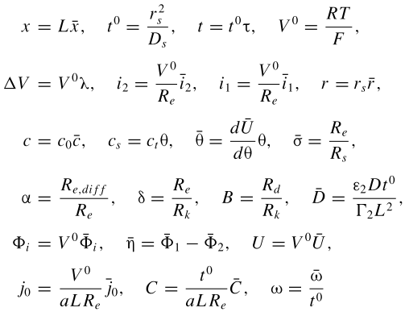
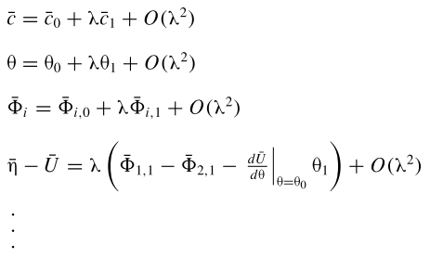
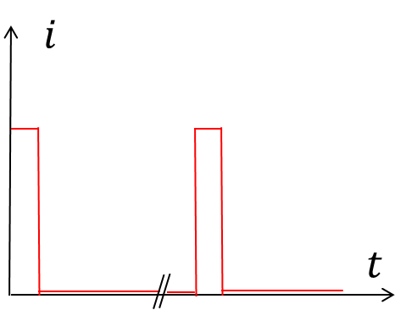
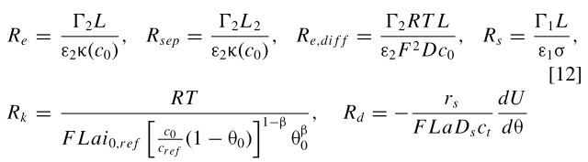

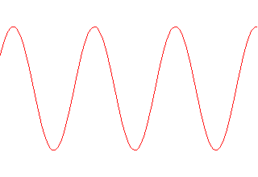
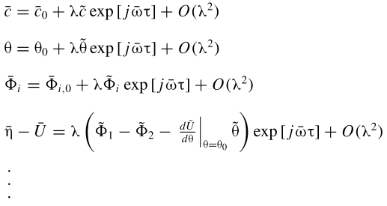
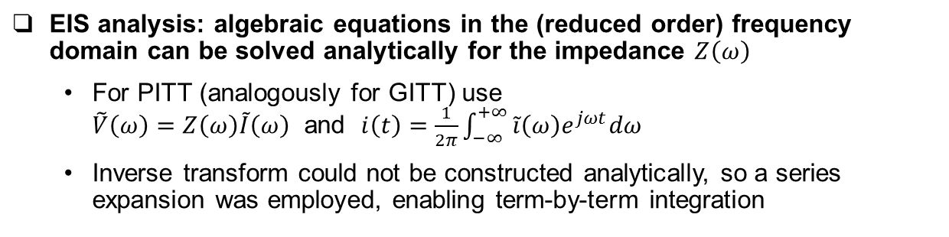

Perturbation analysis
PITT
GITT…same as PITT with the exception that
EIS, $j=\sqrt{−1}$
EIS analysis: algebraic equations in the (reduced order) frequency domain can be solved analytically for the impedance $Z\left(ω\right)$
  For PITT (analogously for GITT) use $\tilde{V}\left(ω\right)=Z\left(ω\right)\tilde{I}\left(ω\right)$ and $i\left(t\right)=\frac{1}{2π}\int_{−∞}^{+∞}{\tilde{i}\left(ω\right)e^{jωt}dω}$
  Inverse transform could not be constructed analytically, so a series expansion was employed, enabling term-by-term integration

Slide 24
Key point: porous electrode parameters and material properties taken directly from the literature (lithiated, graphitic negative electrode)

Slide 25
New solution (builds on Ong & Newman, JECS 1999)
F_{PITT} from the sphere problem discussed earlier
New solution

Slide 26

Key results
for porous electrodes
$$Z\left(ω\right)=\frac{\tilde{V}\left(ω\right)}{\tilde{I}\left(ω\right)}$$
$$i\left(t\right)=\frac{1}{2π}\int_{−∞}^{+∞}{\tilde{i}\left(ω\right)e^{jωt}dω}$$
$$V\left(t\right)=\frac{1}{2π}\int_{−∞}^{+∞}{\tilde{V}\left(ω\right)e^{jωt}dω}$$

Slide 27
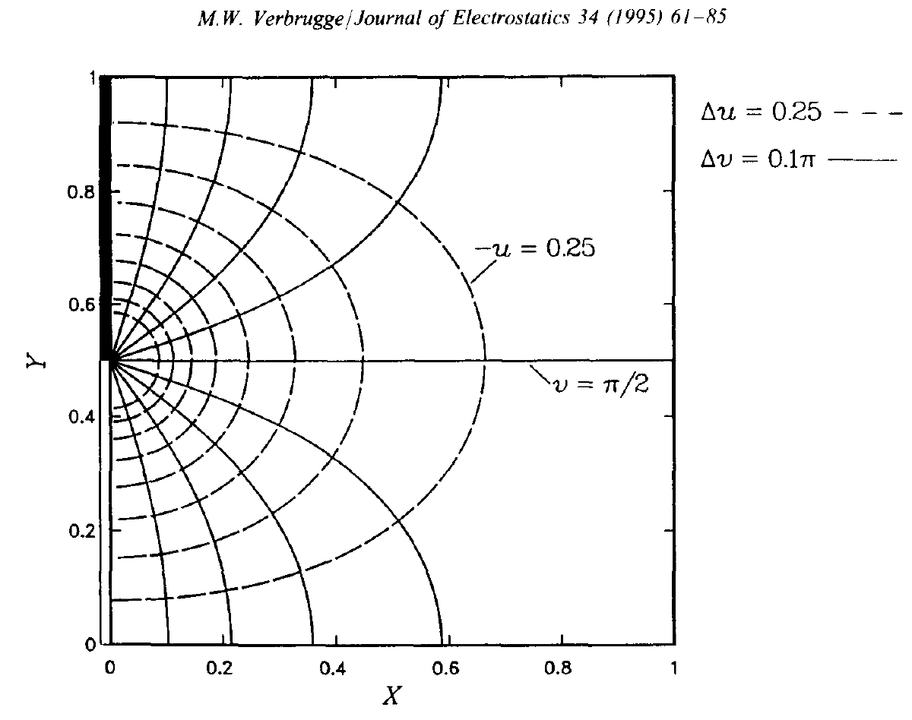
Perturbation solution, h << L, for potential and temperature
a
No electrolyte (separator)
b
With a separator
All three region have the same thickness
Equal electrode conductivities
Infinitely long cell
b
a

Slide 28
Switch to a brief review of battery life modeling. First, the bathtub curve.
Chemical degradation
  Critical role of SEI (solid electrolyte interphase) to impede deleterious degradation reactions within lithium ion cells
  Calendar life determined by chemical degradation
Mechanical degradation
  Cyclic expansion and contraction of insertion or alloy materials leads to fatigue, cracking, and structural changes
  Cyclic life issues are affected by mechanical degradation and chemical degradation
Today’s focus
Number of Failures
Wear out failures
Early (infant mortality) failures
Useful life
(durability)
Time in service

Slide 29
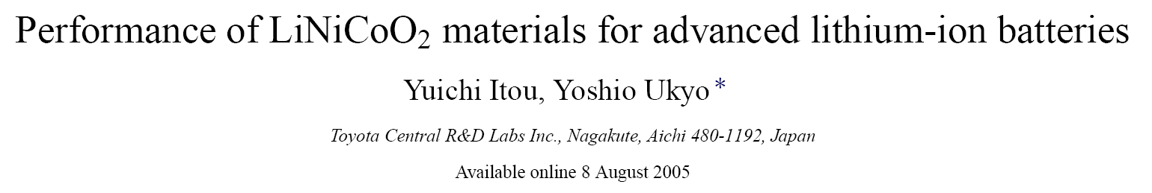

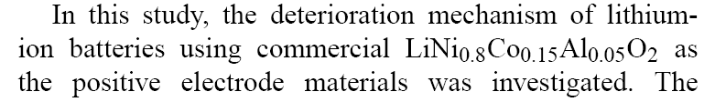

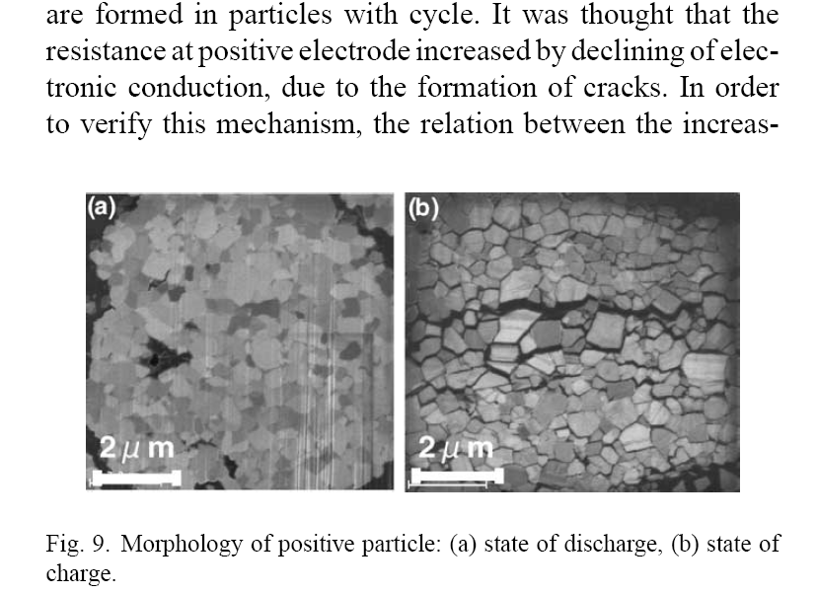
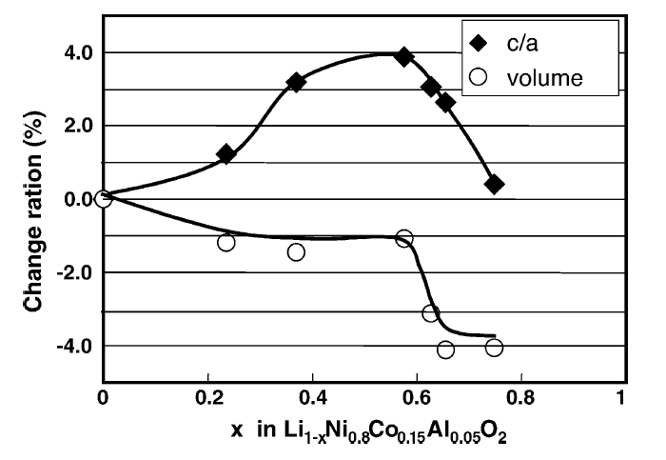
POSITIVE
ELECTRODE
“This result indicates volume change causes the increase in resistance.”

Slide 30
Wöhler S-N curve
(1870…railroad axles)
Stress
Ultimate goal: Determine the endurance limit (cycle life) for insertion electrodes by comprehending the periodic stress
Time
Maximum
Stress
Amplitude
Endurance or fatigue limit
Number of cycles

Slide 31
Direct analogy to the lower cycle-life fatigue…stress amplitude is replaced by ΔSOC
Model result: maximum stress is proportional to the maximum difference in SOC (state of charge), or ΔSOC
M. W. Verbrugge and Y-T. Cheng, “Stress and Strain-Energy Distributions within Diffusion-Controlled Insertion-Electrode Particles Subjected to Periodic Potential Excitations,”
J. Electrochem. Soc., 156(2009)A927

Slide 32
Problem statement
Single Particle Model…particle diffusion resistance dominates, yielding “worst case” stress
Phenomenological stress-strain relations (cf. thermoelasticity)
Phenomenological guest lithium (intercalate) diffusion
Mechanical equilibrium
Y-T Cheng and M. W. Verbrugge, “The Influence of Surface Mechanics on Diffusion Induced Stresses within Spherical Nanoparticles,” J. Appl. Phys., 104(2008)83521
Boundary conditions
  Finite stresses at particle center
  Surface
    surface tension and surface modulus
The equation system can be solved analytically (uniform periodic state)
  Simplified problem statement
  Decoupled concentration problem
  No variable physical properties
  Idealized (spherical geometry)

Slide 33

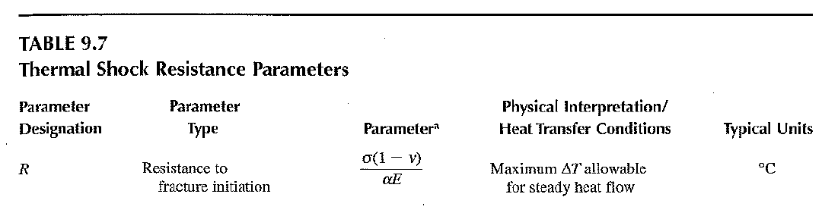
Thermal Shock Resistance (Hasselman)
  The maximum tensile and shear stresses are observed at the surface:
  Set max tensile (shear) stress to fracture stress σ_{F} and combine equations
    This formula implies a maximum permissible ΔSOC (instead of ΔT in Hasselman’s work), above which cracks may form

Slide 34

…adding concentrated solution theory for the irreversible thermodynamics
Small deformation
  D. R. Baker, M. W. Verbrugge, and A. F. Bower, “Thermodynamics, Stress, and Stefan-Maxwell Diffusion in Solids: Application to Small-Strain Materials used in Commercial Lithium-Ion Batteries” J. Solid State Electrochemistry, 20(2016)163
Large deformation (swelling and elastic strain)
  D. R. Baker, M. W. Verbrugge, and A. F. Bower, “Swelling and elastic deformation of lithium-silicon electrode materials” J. Electrochem. Soc., 163(2016)A624-A631
We extend the small-strain treatment employing Stefan-Maxwell diffusion to incorporate swelling of a Li-Si electrode…easily implemented analytic solution obtained
Pragmatic result:
For BEV type batteries, a 1C rate is rather high
  We examine 1C charging (lithiation) of Si. It appears possible to stay below the yield stress of Si under these conditions.

Slide 35


Charles made our knowledge practical
2016/2017 Boss Kettering Award for “Virtual Battery Life Testing and Estimation”
So now, I doubt that I will be publishing in this topic area any time soon!
First approach to couple electro-chemistry, chemical degradation, and fracture mechanics, yielding a life model for LiIon cells

