Slide 1
30 Years at GM with Charles Wampler
From Topological Robotics to Mathematical Fashion Design
Daniel Baker
A conference in honor of Charles Wampler, "Polynomials, Kinematics, and Robotics," June 5 - 7, 2017 at the University of Notre Dame, McKenna Auditorium

Slide 2
List of Topics (in chronological order)
Topological Robotics
Some brief highlights from the next 20 or so years (about which I know almost nothing)
Battery State Estimation
Mathematical Fashion Design
  Joint work with Ellie Baker to be presented at the Bridges conference on mathematics and the arts in Waterloo, Canada, July 2017

Slide 3
Topological Robotics

Slide 4
The PUMA 560 is a robot used for positioning and orienting tasks.

Slide 12
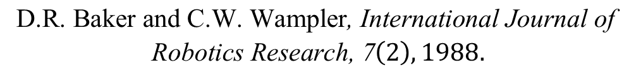
C.W. Wampler, “Winding number analysis of invertible
workspaces for redundant manipulators,” Proc. of 26th
IEEE Conf. on Decision and Control, Dec. 9-11, 1987,
Los Angeles, CA, Vol. I, 564-569.
For more details on these and other results, see also:
$$\begin{matrix}\text{D}\text{.}\text{R}\text{. }\text{Baker} \text{and} \text{C}\text{.}\text{W}\text{. }\text{Wampler}\text{, }\text{International} \text{Journal} \text{of} \\ \text{Robotics} \text{Research}\text{, 7}\left(2\right),1988.\end{matrix}$$

Slide 13
Some Highlights from the Next 20 Years

Slide 14
Charles helped invent the GM Programmable Adaptive Assembly System (PAAS), which GM later contracted out to Fanuc Robotics as their C-flex product.
These robots hold parts in correct alignment while large welding robots join them. The C-flex units can reconfigure to build multiple car body types on the same equipment. For interchangeability, every unit is calibrated using methodologies developed by Charles.
Robots working in tandem make for complicated operational spaces!
Notes:
A PAAS cell as planned in CAD and as implemented in the Orion Assembly plant.
This was an early in-plant beta test – these silver-colored PAAS units were built by GM before the deal with Fanuc.

Slide 15
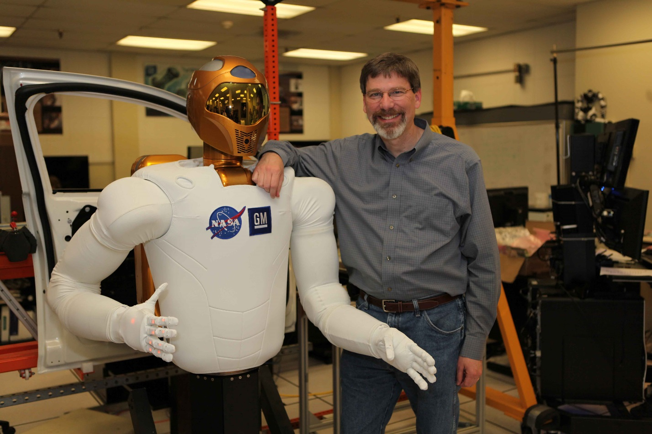
Charles with Robonaut 2 (R2) in the lab at Johnson Space Center, Houston, April 2010
R2 has 42 degrees of freedom, including two 7-DOF arms.
Charles helped with many aspects of the design and the controls (arm layout, closed-chain wrist design, finger tendon controls, high-level kinematic controls).
Calibration came up again here, this time for eye-hand coordination.
Collaboration between GM and NASA

Slide 16
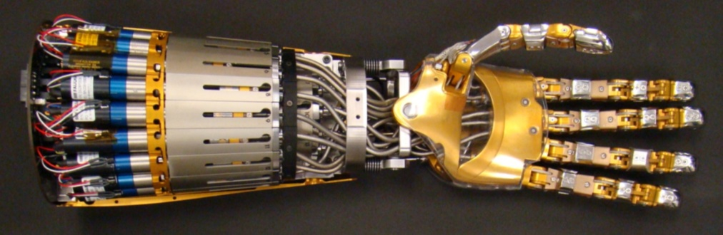
A lot of redundancy in R2’s hand!
Notes:
CAD image of R2 hand and wrist.
Actual photo with motors and sheathed tendons installed.

Slide 17

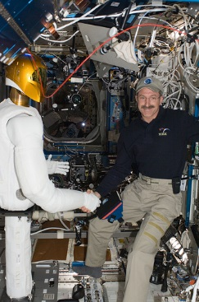
R2 was launched to the International Space Station in February 2011 on the last flight of space shuttle Discovery.
Here is R2 shaking hands with an astrounaut.

Slide 18
Battery State Estimation

Slide 19

Battery models can be roughly divided into two parts: State of Charge and State of Power.
(1) State of Charge and Thermodynamics: This describes the battery behavior at equilibrium when no current is being drawn.
  The Open Circuit Voltage (OCV) describes how the voltage varies as a function of State of Charge (SOC).
  SOC is a number between 0 (empty battery) and 1 (fully charged).
  SOC is like a fuel gauge on a battery. It tells you how far you can still drive before you need to charge the battery.
  The thermodynamic response is very nonlinear!
$$OCV$$
0
SOC
1

Slide 20
Battery models can be roughly divided into two parts:
(2) State of Power (SOP) and the dynamics of irreversible processes
  If a sudden burst of current is needed, the voltage will drop suddenly, for example, during acceleration to pass another car.
  After the acceleration is over, the voltage will recover to it’s thermodynamic value at open circuit (OCV).
  Even if the SOC is nonzero, there is a limit to how much power (energy/time) can be gotten from the battery. This is called the State of Power.
  The on-board diagnostics need to know what the SOP of the battery is, even if the SOC is nonzero.

Slide 21
On-board diagnostics require a model that can compute SOC and SOP in real time as the car is driven.
The most detailed models of SOC and SOP couple these processes together in a complicated system of partial differential equations, but these models are too computationally intensive for use in on-board diagnostics.
Simpler models can be based on circuit diagrams consisting of resistors and capacitors.
  These linear models are used to describe the SOP, and they are coupled to a nonlinear representation of the OCV to describe SOC.
  What are the limits of a linear model of SOP?
  What kind of circuits does one need to describe SOP?
  One assumes either that a time-dependent voltage V(t) is given across the circuit, so that one must calculate the current I(t), or conversely one must calculate the voltage given the current.

Slide 22


Canonical R-C circuit Theorem by Charles Wampler
  Suppose we have a two-terminal circuit containing a finite number of resistors and capacitors.
    Batteries are two-terminal devices.
    They typically have no discernable inductance in the frequency range of interest for battery control (i.e., below ~10Hz).
  Theorem:
    There exist equivalent R+N(R||C) and R||N(R+C) circuits with the same I/O behavior,
    where N is no greater than the number of capacitors in the original circuit.
$$⋯$$
$$⋯$$
R+N(R||C)
R||N(R+C)
Impedance Canonical Form
Admittance Canonical Form
Notes:
(Slides 14-16 discuss the Canonical R-C Circuit Theorem proved in CMS-224/PSR-098, Baker, Verbrugge, Wampler, Hu 2014)

Slide 23
Some comments on Charles’ theorem
It greatly simplifies the possibilities that must be considered when building a model.
It is a little hard to believe that this theorem wasn’t known (perhaps by someone in the 19th or early 20th century), but we haven’t been able to find it in the literature.
How many R||C pairs does one need in the model?
  In general, this can be decided by measuring the impedance of a battery at different temperatures and seeing how many R||C pairs are needed to match the impedance spectra.
How about high power situations when the battery exhibits nonlinear dynamics?
  The models need to be expanded somewhat to describe this behavior, but we won’t get into these details.

Slide 24






Sketch of Proof
$$Z\left(s\right)=\frac{q\left(s\right)}{p\left(s\right)}$$
$$ℑ(s)$$
  APZ Definition: An impedance is said to be of Alternating Pole-Zero (APZ) form if its poles and zeros are interlaced on the negative real axis (starting with a pole, possibly at zero).
  Single resistors or capacitors have APZ form.
  Starting with single resistors and capacitors, use circuit reduction to show that the whole circuit has APZ form.
  Circuit Reduction: Each step preserves APZ form.
    Parallel transformation: Two impedances in parallel can be replaced with a single equivalent impedance.
    Star-mesh transformation: Any star circuit with N arms can be replaced with a mesh circuit with just N nodes having the same impedance as before.
    Reduction: Any two-terminal circuit can be reduced to a single equivalent impedance with a finite number of parallel and star-mesh transformations.
  Any impedance with the APZ property can be represented as a R+N(R||C) circuit.
$$ℜ(s)$$
APZ
$$Z_{1}$$
$$Z_{1}∥Z_{2}$$
$$Z_{2}$$
Parallel
Star
Mesh

Slide 25
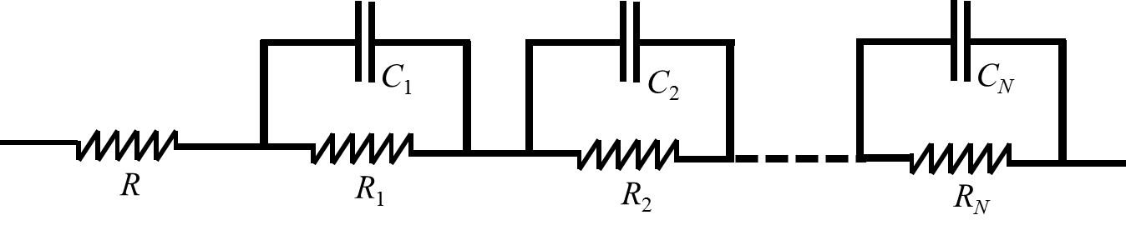
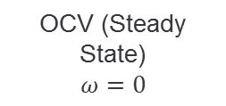








Elements of An Equivalent-Circuit Battery Model
$$v_{0}$$
$$R_{∞}$$
$$v_{1}$$
$$v_{2}$$
$$v_{N}$$
$$v_{∞}$$
SOC
OCV (Steady State)
$$ω=0$$
Middle Frequencies
1 mHz $<ω<$ 10 Hz
High-Freq. Resistance
$$ω→∞$$
Thermodynamics
Transport/Diffusion
Kinetics
> Battery model must cover all relevant frequencies.
> Equivalent circuit model has a finite number of parameters to adjust.
> Canonicity theorem: R+N(R||C) suffices to model any linear non-inductive impedance.

Slide 26
Mathematical Fashion Design
Joint work with Ellie Baker

Slide 27
“For mathematicians among you who don’t know what an infinity scarf is, the classic design is a cloth torus whose hole is large enough to fit over the head so that it can be looped around the neck one or more times.” Ellie Baker
The problem: Design a reversible infinity scarf with different patterns on each side.

Slide 28
Inverting tori is a funny business
Surot, public-domain animated gif
The meridians on the torus get switched!
For infinity scarves, this can be disastrous!
Neckware for a giraffe!

Slide 29
We want the geometry of the infinity scarf to be invariant under inversion. But there is more.
We want the scarf to be ribbon foldable.
This means that you can lay it flat on the table with a finite number of folds.
Ribbon foldable scarves drape better around your neck, in particular the Moebius version (see next slide).

Slide 30
Theorem: There are exactly two ribbon-foldable torus designs that are shape-invariant under inversion.
If the fundamental region of the torus is square (see above) then it can be sewn to be ribbon foldable with an even number of folds.
If instead the fundamental region is a rhombus with a 60 degree angle in two corners, then it can be sewn to be ribbon foldable with an odd number of folds.
  This is the so-called “Moebius scarf” which only has one side when flattened and folded.
  The Moebius scarf drapes best around your neck!

Slide 31
But there’s more…
The end result turns out to be precisely the Moebius scarf that is shape invariant under inversion.

Slide 32
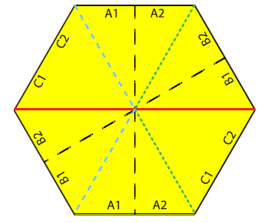
More fashion and sewing issues
The scarf was designed have a repeating pattern on both sides. For this purpose it helps to consider the wallpaper groups.
The construction of the scarf is determined by the choice of fundamental region which is cut out of cloth and then sewn together.
  The fundamental region will have the area of 6 equilateral triangles.
  Three possible regions are shown below.
  The hexagonal region has the smallest perimeter, which minimizes the seam length.
The “Honeycomb Conjecture,” proven in 1999 by Hale, states that “any partition of the plane into regions of equal area has perimeter at least that of the regular hexagonal honeycomb tiling.” Since any valid scarf layout tiles the plane with tiles of equal area, there is no layout with a seam length shorter than the hexagon. For this reason, we consider a hexagon the quintessential layout for our scarf.

Slide 33
For further information see:
Ellie Baker and Charles Wampler, “Invertible Infinity: A Toroidal Fashion Statement,”
To appear in the Proceedings of
BRIDGES WATERLOO 2017, Mathematics, Music, Art, Architecture, Education, Culture
University of Waterloo
Waterloo, Ontario, Canada
27–31 July, 2017
For more information on wallpaper groups and crafting see
Ellie Baker and Susan Goldstine. “Crafting Conundrums: Puzzles and
Patterns for the Bead Crochet Artist” AK Peters/CRC Press. 2014.

Slide 34
Extra slides

Slide 35



Slide 36
